Slide 1

Understanding
Career Aspirations
of Gen-Z
Presented by ranveer surkuntwar

Slide 2

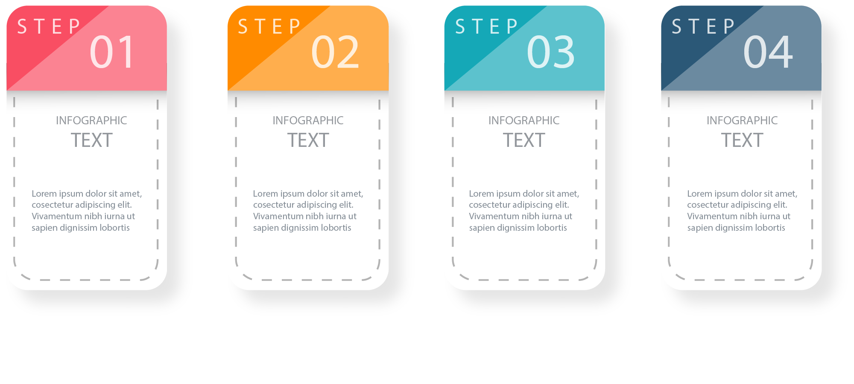
ROAD MAP
05
06
Introduction to the problem statement and researching about it.
Approaching the problem statement and creating business research document
Data collection and cleaning using SQL.
Analysis of Business questions using SQL.
Creating a comprehensive Dashboard
and
Focus area Dashboard.
The Final Insights

Slide 3

Introduction to the problem statement and researching about it to get a better understanding
Problem Statement : Understanding Career Aspiration Of Gen Zs
Generation Z, those born after 1996 and known as digital natives, really value entrepreneurship, social responsibility, and personal achievement. This often leads them to pursue careers in tech, social media, and entertainment. Many Gen-Z individuals are interested in starting their own businesses, taking risks, and following their passions. They also have a strong desire to make a positive impact on the world, so they often choose careers in areas like social justice, sustainability, and environmentalism. Growing up in the digital age, Gen-Z is comfortable with technology and often dreams of working in tech-related fields such as software engineering, data analytics, and cybersecurity. They also highly value a good work-life balance and flexibility in their careers, preferring jobs that allow them to work from home or have flexible schedules. Additionally, Gen-Z is big on personal development and looks for careers that provide ongoing learning opportunities, like mentorship programs.
Article used for research and understanding : https://www.studocu.com/in/document/university-of-mumbai/bsc-information-technology/understanding-the-career-aspiration-of-gen-z/70073256

Slide 4
Approaching the problem statement and creating a Business Research Document.
who are affected by not understanding the career aspiration of generation-z –
Companies : Gen-z will make their work more easier because in current scenario gen-z is are more skilled focused.
Education/universities - They may find challenging to make relevant and effective courses carrier services without understanding of Gen-Z’s aspirations, it can lead to decreased enrolment rates.
Family : Parents desire a balanced work-life for their Gen Z child.
What is happening?
Companies : if companies understand their aspirations and gen-z’s are aligned with your company vision, they could be a great fit and that can solve many challenges.
Lack of skills : more of degree because our educational curriculums not changed so it still focused on degree instead of skills, people stuck with the degree not on skills they facing lack of skills and for companies it increasing cost and burden.
Example – A company hires employees based on degrees but faces challenges when they lack essential technical skills
Where is this happening :
The challenge of not understanding the career goals of Generation Z isn't limited to a particular location; it's widespread, notably in major tech cities that are experiencing significant growth in the IT industry. The global consequences of this issue became more apparent after the
Covid-19 pandemic, affecting businesses worldwide, both traditional and tech-driven. In India, though the country followed global trends, there were fewer massive layoffs. However, the impact is particularly concentrated in tech hubs, emphasizing the urgent need for organizations to adjust their strategies to match the career aspirations of Generation Z.
When is this happening?
Timeline of Change: - Emergence timeline is unclear, but trends are shaping up in the past few years.
Post-Covid-19, a significant event influencing Gen Z's mindset towards work-life balance.
Lockdown Impact on Tech Companies:
During and after the lockdown, tech companies recognized the benefits of remote work.
Full-time or partial work from home emerged as a strategy, saving costs and boosting employee morale.
Shift in Gen Z's Lifestyle:
Gen Z is reevaluating priorities, placing a greater focus on work-life balance.
Time saved from reduced office commute enhances personal lives, fostering prosperity.

Slide 5
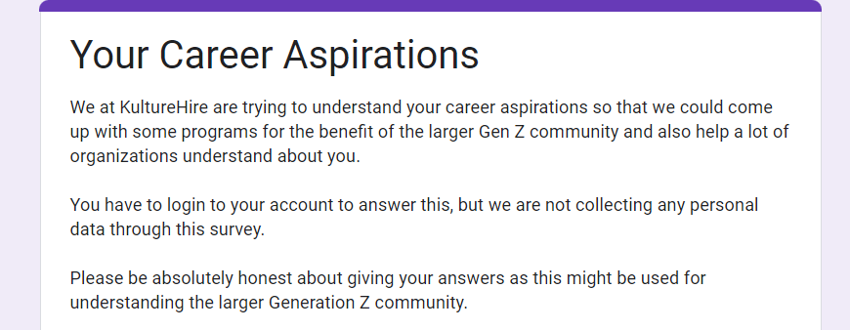
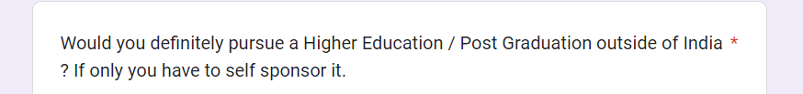
DATA COLLECTION
Data collection is to capture quality evidence that allows analysis to lead to the creation of convincing and reliable answers to the questions asked.
For our problem statement we gathered data from the Gen-Zs through platforms like LinkedIn, Instagram, etc.
We received around 3400 complete forms and around 50,000 responses. The responses were roughly from 1800 different Postal codes across India.

Slide 6
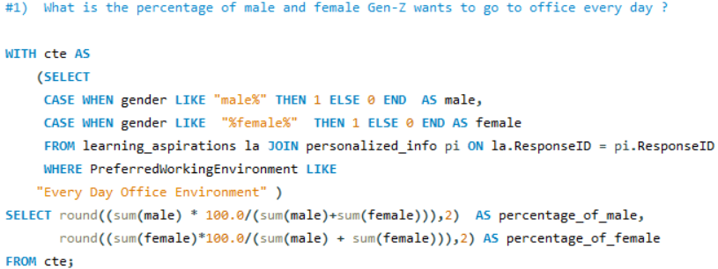

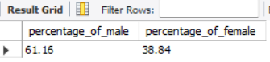
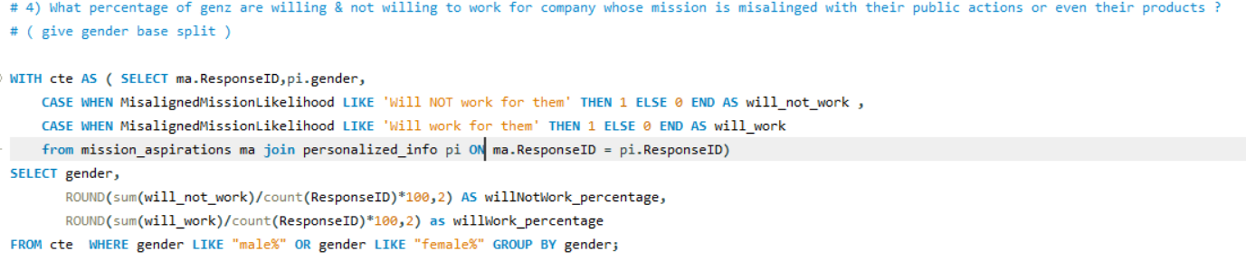
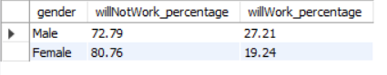
Cleaning the data and Analysis of Business questions using SQL.
We worked on MYSQL Server Workbench. Imported data from csv and xlsx files to the server, wrote codes to get the answers to the required for the Analysis of Business questions.
We solved 22 business questions and here we have some snippets of the codes along with the outputs:

Slide 7

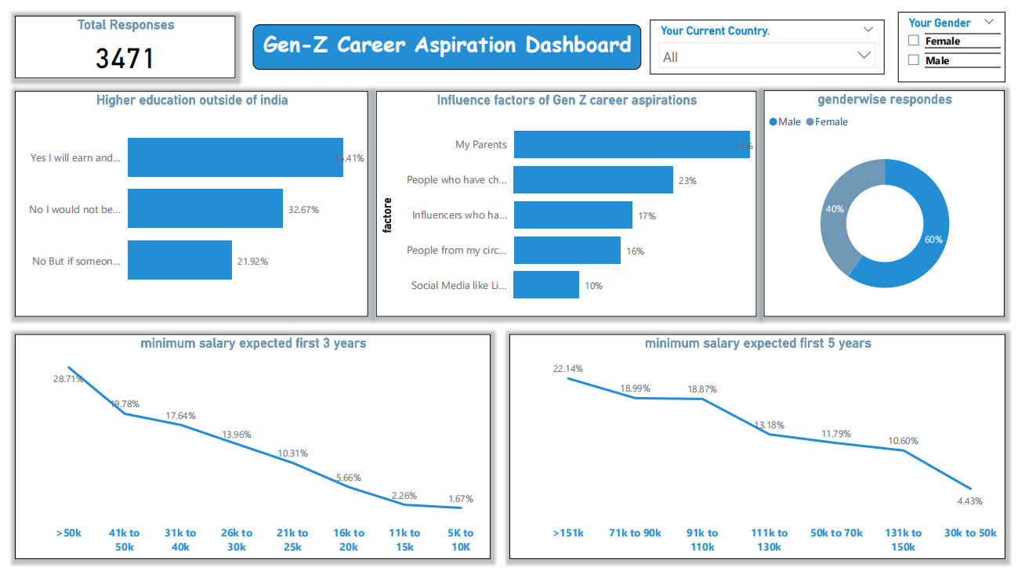
EXECUTIVE DASHBOARD

Slide 8
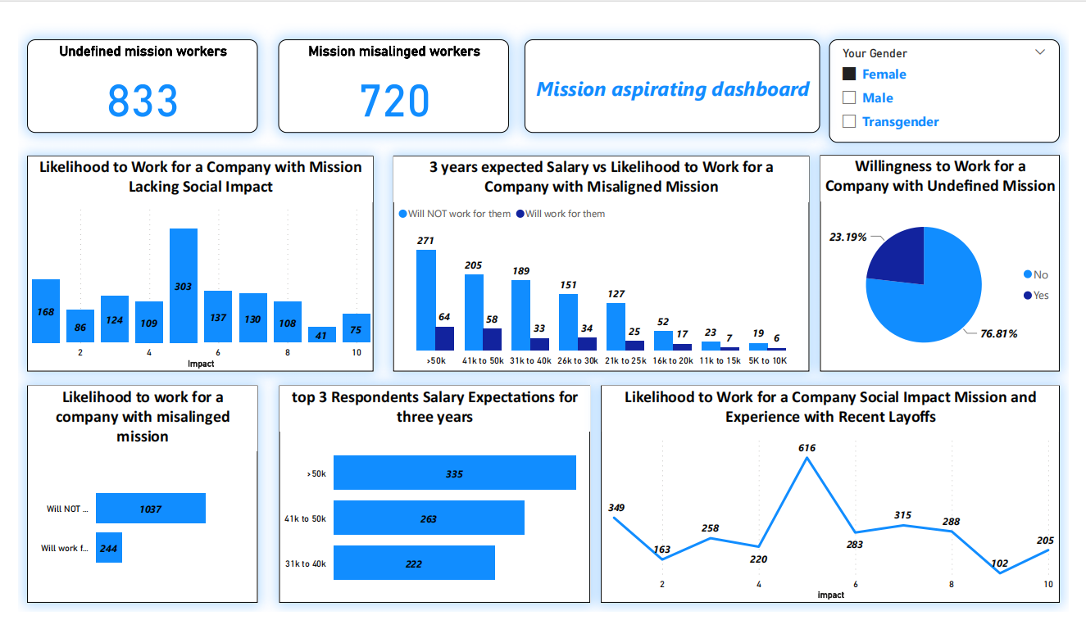
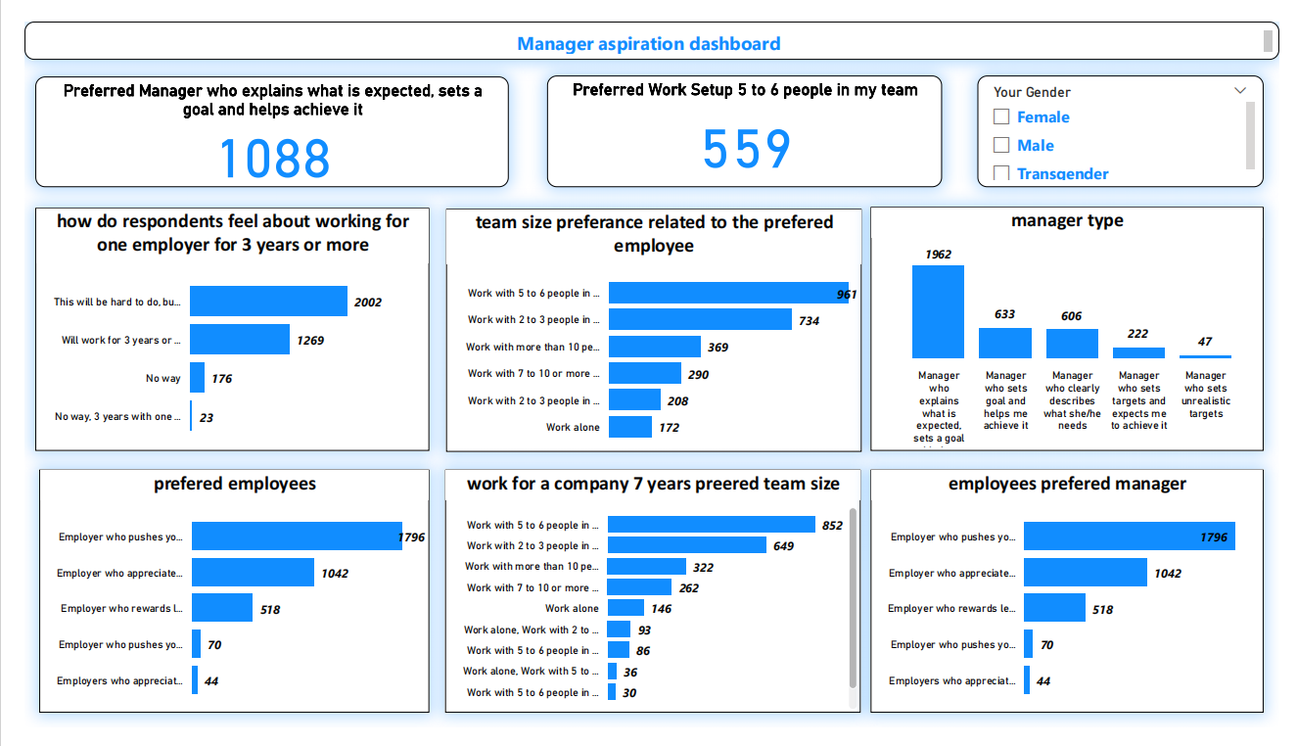
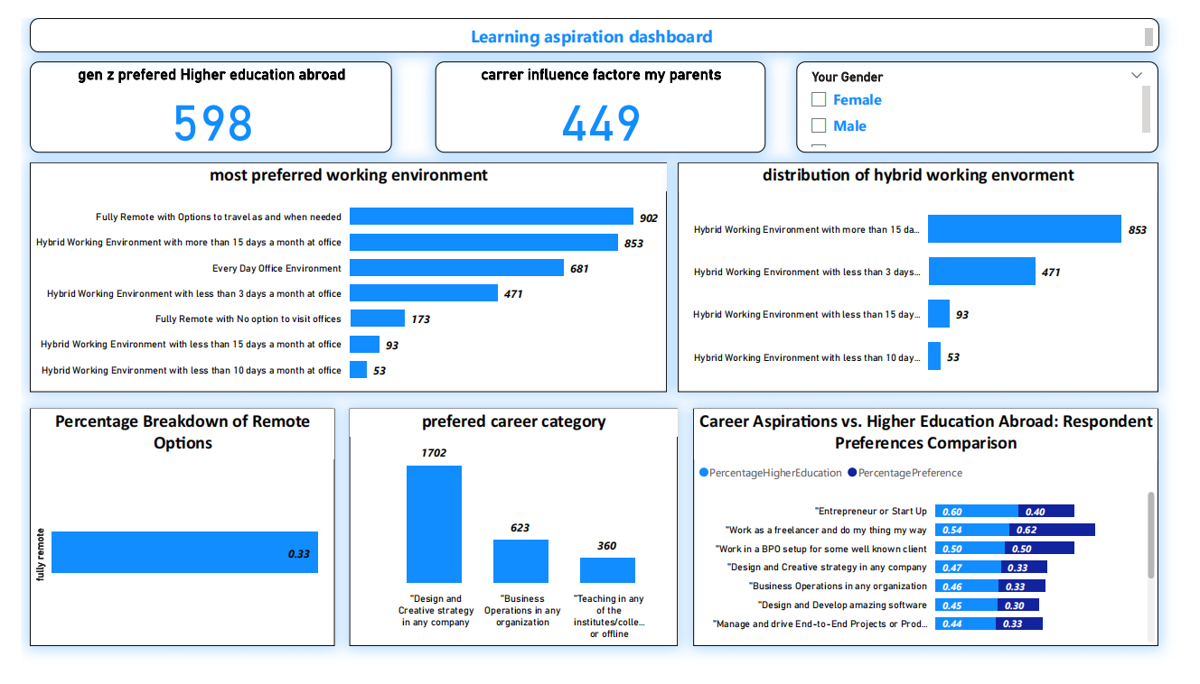
Focused area dashboard
We made three focused dashboards along with one comprehensive dashboard. These three dashboards were based of 3 aspects :
Manager Aspirations
Learning Aspirations
Mission Aspirations

Slide 9

EMPLOYER OVERVIEW
Company name :
Dream 11
About company :
Dream11 is an Indian fantasy sports platform that allows users to play fantasy cricket, hockey, football,
kabaddi, handball, basketball, volleyball, rugby, futsal, American football and baseball.
started in 2008 by Harsh Jain and Bhavit Sheth .
Dream11 was the first company in India to introduce the concept of Fantasy sports.
It is a fully licensed and regulated company.
In April 2019, Dream11 became the first Indian fantasy sport company to become a unicorn.
Dream11 reached a milestone of 200 million users.
Overview : Dream11 Reviews 3.8 based on 239 reviews from Glassdoor.
Ratings by category Ratings distribution
4.1 Compensation and Benefits 5 stars 56%
3.9 Career Opportunities 4 stars 17%
3.7 Culture and Values 3 stars 7%
3.3 Senior Management 2 stars 5%
3.1 Work/Life Balance 1 star 15%

Slide 10
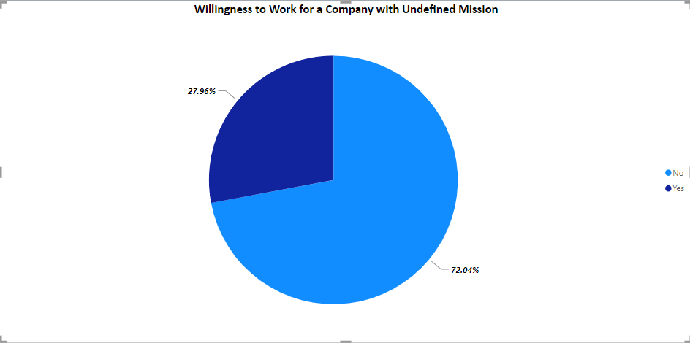
FACTOR OF COST
PROS :
Great culture and processes for daily stuff and strategy (in 39 reviews)
Good Benefits (in 13 reviews)
Competitive salary+ ESOPs (in 12 reviews)
CONS :
No work life balance at all (in 23 reviews)
Upper management is a little weak (in 4 reviews)
life balance is encouraged
Recommendation :
Based on reviews there's not a good balance between work and personal life at Dream11 .
To fix this, I suggest creating a clear mission statement to guide everyone and make the work culture better.
Also, having more flexible work options can help make the work environment more balanced and productive.

Slide 11
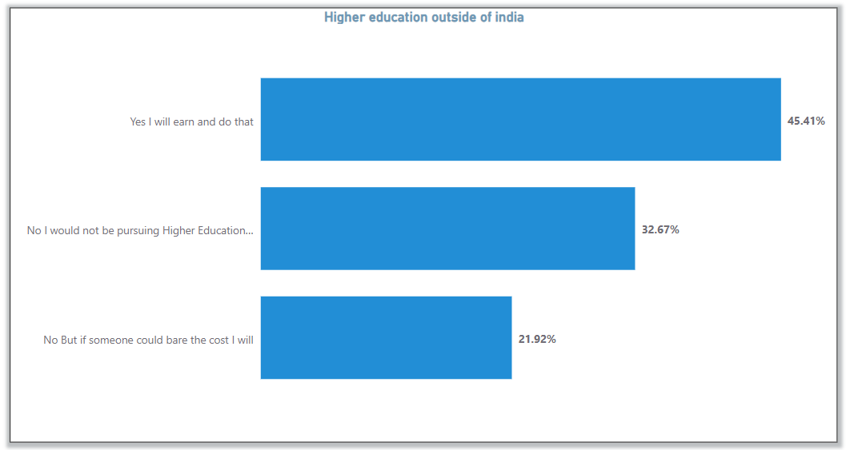
Final insights and Recommendation
- According to the survey on higher education outside India, 1465/45% of respondents expressed the intention to earn and pursue such education,
- While 1054/32% stated they would not,
- 707/23% indicated they would consider it if someone else covered the costs.
Recommendation :
Implementing financial assistance programs or scholarships to support Gen Z , consider offering opportunities within the company that align with educational goals.

Slide 12
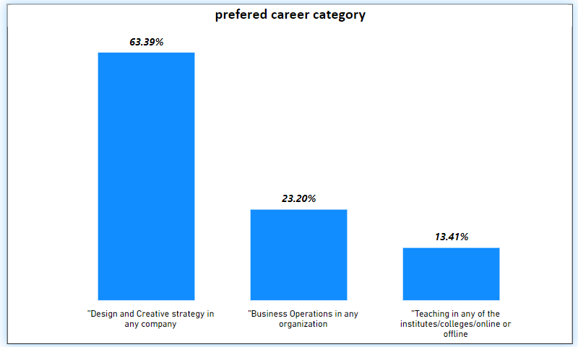
Final insights and Recommendation
- Design and creative strategy leads with 1702,
-Business operations, at 623
-Teaching, with 360, makes up about 12% of the chart
Recommendation :
Gen Z appreciates workplaces that encourage new ideas and creativity.
Highlighting a lively and innovative culture can make the company more attractive to them.

Slide 13
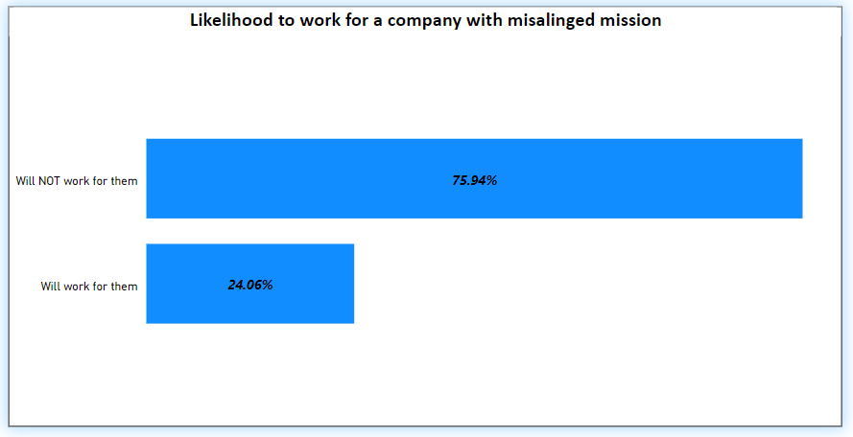
Final insights and Recommendation
- Approximately 75.94% of GenZ individuals surveyed are not willing to work for a company with a misaligned mission.
- 765 GenZ’s are may still consider working for a company with a misaligned mission
Recommendation :
Make sure the company's mission is clear to everyone.

Slide 14
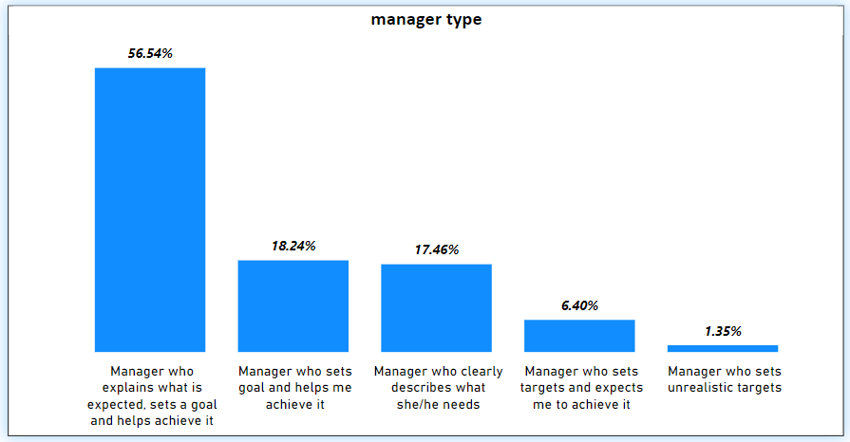
Final insights and Recommendation
- Most people 1962 individuals like it when their manager tells them what's expected, sets goals, and helps them reach those goals,
- Some people 633 individuals prefer a manager who sets goals directly and helps them achieve those goals, although this preference is less.
So on
Recommendation :
Adjust how managers work with GenZ by making sure they clearly communicate, set goals, and offer support.

Slide 15

Thank you Slide
RANVEER SURKUTWAR
ranveerreddy0505@gmail.com

